Slide 1

DigiErratum using AI, ML & NLP
Govind Singh(2000290120066)
Aman Raj Singh(2100290129003)
Anshul Sharma(2000290120031)

Slide 2
Introduction
DigiErratum stands for digital erratum (Latin word means error correction) is a software that checks your fluent for grammatical mistakes, appropriate punctuation, misspellings, and issues related to sentence structure as well as it behave as a assistant for the user. It uses different technologies like AI, ML and NPL to do the same.
English as a universal language in the world will get more and more attention, but English is not our mother tongue, and there exist differences in culture and thinking. English grammar is the most difficult problem to solve. There are many English learners, and the number of English teachers is limited, and it is inevitable to use Internet technology to solve the problem of lack of resources so DigiErratum provides us the solution to this by correcting the incorrect sentence speak by the user and the assistant normally ask the user that "Do you want to say this.." as user say yes the assistant continue the conversation.
With the increasing update of computers and the Internet, tens of thousands of users tend to write and communicate in English in their daily work. For users whose native language is not English, writing in English is a major obstacle for them. Grammar checking technology originated from the application of natural language understanding. The standard of grammar directly affects the fluency of sentences. The grammar checking system introduced in this article can efficiently check out grammatical errors in sentences and automatically generate correct sentences to replace the wrong one.

Slide 3
Problem Statement
During these days most of the people wants to learn and speak English but they are self-effacing when they try to communicate, so using DigiErratum they can easily practice English speaking without any hesitation and improve their English speaking and feel confident while talking to someone.
Sometime we need to write a big paragraph on some grammatical error correction site to check weather our paragraph is correct or not. It takes so much time but using DigiErratum we can do the same, by only speaking the whole paragraph. It is for any kind of age people and who are physically challenged person they can communicate with the assistant easily and improve their English speaking. It is basically works as virtual assistant so there will be no need of writing. It will save our time.

Slide 4
Objective
With the help of this Project following objectives can be achieved:
A user friendly assistant system.
A model that will help every age group people to improve/learn English.
Learning via communicating with the device.
Self-effacing person can practice on DigiErratum and improve their English as well as enhance his/her confidence and become a good public speaker.

Slide 5
PROPOSED METHODOLOGY
Grammar error correction (GEC) is an important application aspect of natural language processing techniques. The past decade has witnessed significant progress achieved in GEC for the sake of increasing popularity of machine learning and deep learning, especially in late 2010s when near human level GEC systems are available. . Since GEC is typically viewed as a sister task of machine translation, many GEC systems are based on neural machine translation (NMT) approaches, where the neural sequence-to-sequence model is applied. Ensure that your abstract reads well and is grammatically correct. We present the first survey in grammar error correction (GEC) for a comprehensive retrospect of existing progress[2]. Machine learning models are well suited to these kinds of data, allowing researchers to model highly complex relationships and to evaluate the generalizability and robustness of their results using resampling methods. The correct usage of machine learning models requires specialized methodological training that considers issues specific to this type of modelling.[3].
In the IoT world, intelligent virtual assistant (IVA) is a popular service to interact with users based on voice command. For optimal performance and efficient data management, famous IVAs like Amazon Alexa and Google Assistant usually operate based on the cloud computing architecture. In this process, a large amount of behavioral traces that include user’s voice activity history with detailed descriptions can be stored in the remote servers within an IVA ecosystem. If those data (as also known as IVA cloud-native data) are leaked by attacks, malicious person may be able to not only harvest detailed usage history of IVA services, but also reveals additional user-related information through various data analysis techniques. In this paper, we firstly show and categorize types of IVA-related data that can be collected from popular IVA, Amazon Alexa. We then analyze an experimental dataset covering three months with Alexa service, and characterize the properties of user’s lifestyle and life patterns.

Slide 6
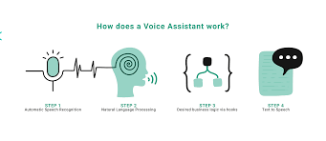
Our results show that it is possible to uncover new insights on personal information such as user interests, IVA usage patterns and sleeping/wake-up patterns. The results presented in this paper provide important implications for and privacy threats to IVA vendors and users as well[4].
Machine learning (ML) provides a powerful framework for the analysis of high-dimensional datasets by modelling complex relationships, often encountered in modern data with many variables, cases and potentially non-linear effects. The impact of ML methods on research and practical applications in the educational sciences is still limited, but continuously grows, as larger and more complex datasets become available through massive open online courses (MOOCs) and large-scale investigations. The educational sciences are at a crucial pivot point, because of the anticipated impact ML methods hold for the field. To provide educational researchers with an elaborate introduction to the topic, it provide an instructional summary of the opportunities and challenges of ML for the educational sciences, show how a look at related disciplines can help learning from their experiences, and argue for a philosophical shift in model evaluation. We demonstrate how the overall quality of data analysis in educational research can benefit from these methods and show how ML can play a decisive role in the validation of empirical models. Specifically, it(1) provide an overview of the types of data suitable for ML and(2)give practical advice for the application of ML methods[5].
Fig:1 WorkingModel

Slide 7
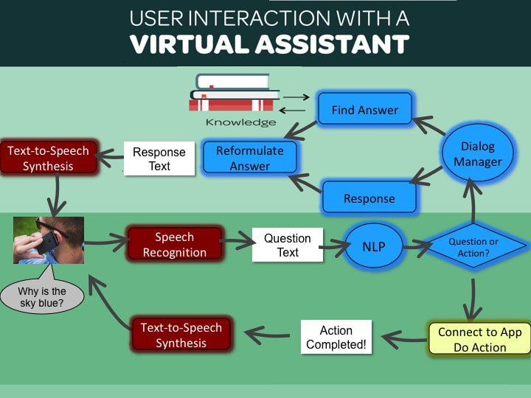
Fig:2 Virtual Assistant interaction with user

Slide 8
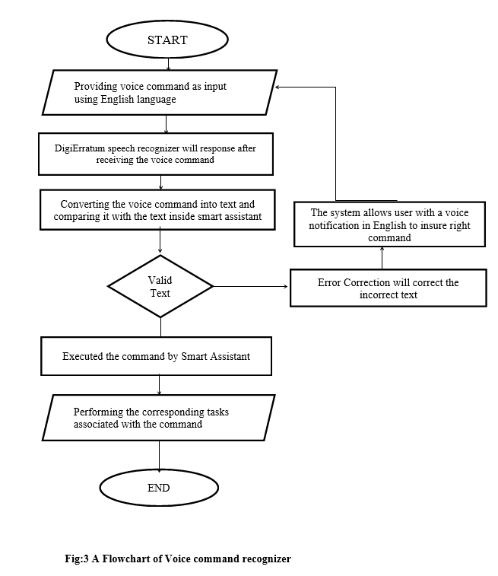
Flowchart

Slide 9
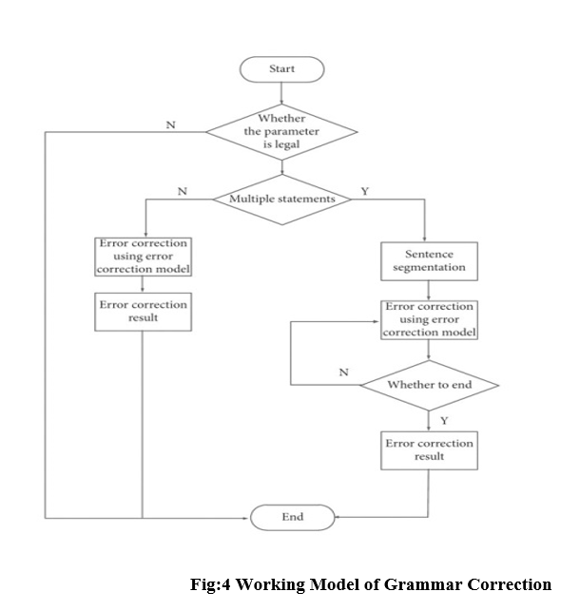
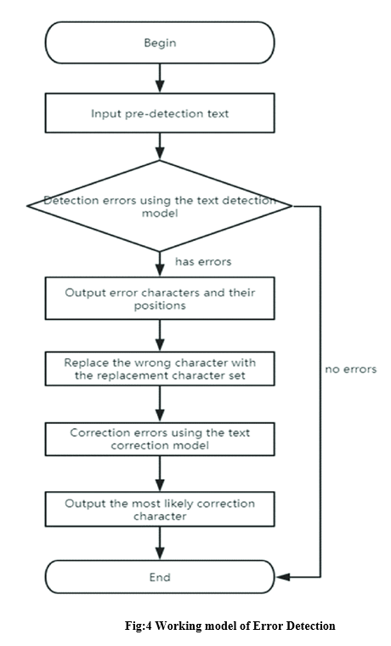

Slide 10
SCOPE
The overall purpose of DigiErratum is to Improve English language free of cost so that everyone can access it easily and it is very user-friendly model where user can select his/her topic of interest to communicate with the assistant which makes it an interactive platform where user enjoy learning. By providing all these features DigiErratum is a futuristic model and in future it can be one of the best platform to learn English.

Slide 11
CONCLUSION
We have shown that it is possible to create a model that can communicate and also correct the incorrect sentences with the help of its various features we have go through various technologies to make this model like AI (Artificial Intelligence) , ML (Machine learning) and NLP (Natural language processing) and we have obtained encouraging results.
One of the most important learnings from this project is that ASSISTANT IS KING without assistant the conversation with a machine is not possible and we would not have been able to build a robust enough model.
From a personal perspective, we have tremendously enjoyed this project, the hardest so far,as it enabled me to gain more practical experience of Machine learning, AI and NLP and more other concept as well.

Slide 12
Thank you
Govind Singh(2000290120066)
Aman Raj Singh(2100290129003)
Anshul Sharma(2000290120031)

